Slide 1

E-COMMERCE CUSTOMER ANALYSIS DASHBOARD
A Power BI Project

Slide 2




Project Objectives
Defining the path to actionable e-commerce intelligence.
ANALYZE
UNDERSTAND
Deep dive into customer behavior and sales data.
Decipher key purchase and return patterns.
IDENTIFY
SUPPORT
Pinpoint high-value customer segments (RFM).
Provide data-driven strategic decision support.

Slide 3
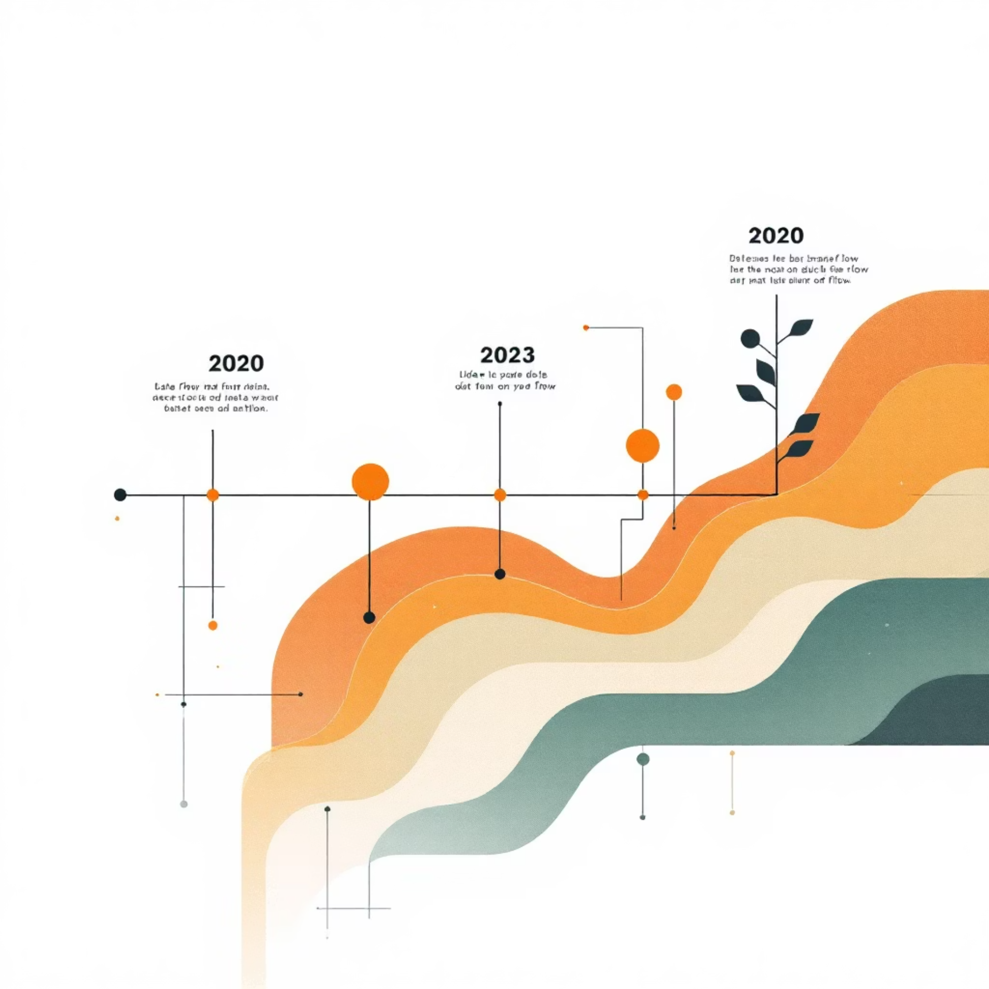
Dataset Overview: Core Metrics
Analysis spanning three years of comprehensive e-commerce transaction data.
Key Data Dimensions
250K+
$681M+
Total Orders
Total Revenue
Transaction ID
Order Details
Volume of transactions processed.
Gross revenue generated across the period.
Order Date
Timeline Coverage
Customer ID
RFM Basis
49,661+
Age & Gender
Demographics
Unique Customers
Product Category
Sales Drivers
Size of the analyzed customer base.
Return Status
Loss Analysis

Slide 4



Tools & Analytical Workflow
From raw data to actionable insights: a structured 5-step process.
DATA CLEANING
DATA MODELING
RFM SEGMENTATION
Transforming raw data; ensuring accuracy and completeness.
Building relationships and optimizing data structure (DAX).
Classifying customers by Recency, Frequency, and Monetary value.
DASHBOARD CREATION
ACTIONABLE INSIGHTS
Extracting strategic findings for business optimization.
Developing interactive and intuitive visual reports in Power BI.

Slide 5
Data Cleaning
Objective: Ensure accuracy, consistency, and usability of raw e-commerce data
Steps Taken:
Removed duplicates and null values
Standardized column formats (dates, categories, gender)
Handled outliers in revenue and age
Verified customer IDs and transaction integrity

Slide 6
📊 RFM Segmentation
Goal: Classify customers based on purchasing behavior
RFM Metrics:
Recency (R): Days since last purchase
Frequency (F): Number of purchases made
Monetary (M): Total revenue generated
Segmentation Logic:
Scored each customer on R, F, M (1–5 scale)
Combined scores to assign segments:
Loyal / VIP: High R, F, M
Potential Loyal: High F & M, moderate R
At Risk: Low R, moderate F & M
Lost: Low across all three

Slide 7
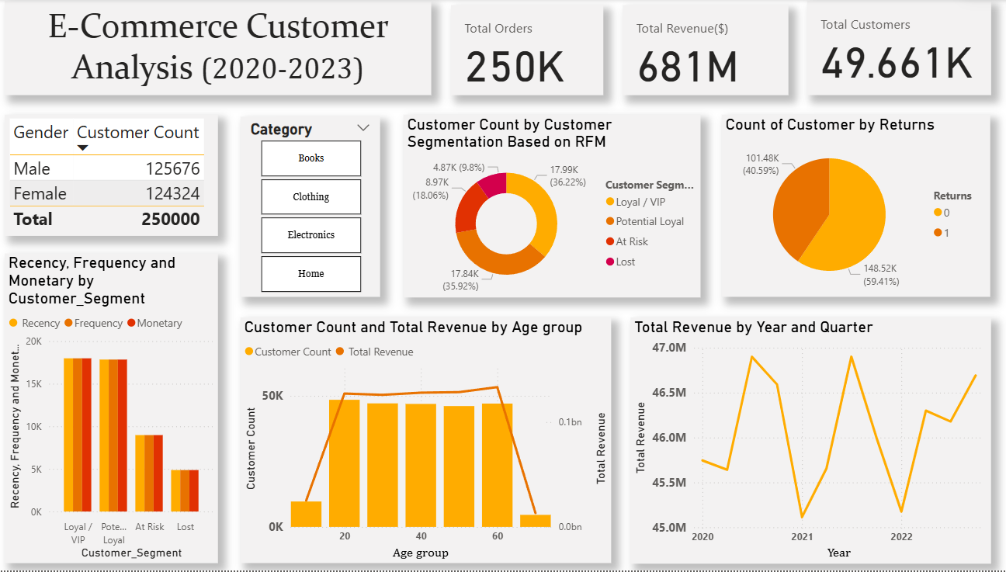
📊 Chart 1: Gender Customer Count
Slide Title: Gender Distribution of Customers
Slide Text:
Male: 125,676
Female: 124,324
Balanced customer base with near-equal gender representation
Indicates inclusive product appeal across demographics

Slide 8
Chart 2: Customer Segmentation (RFM)
Slide Title: RFM-Based Customer Segmentation
Slide Text:
Loyal/VIP: 36.22% (17.99K)
Potential Loyal: 35.92% (17.84K)
At Risk: 18.06% (8.97K)
Lost: 9.8% (4.87K)
Over 72% of customers show strong loyalty potential
Foundation for targeted retention strategies

Slide 9
Chart 3: Returns Analysis
Slide Title: Customer Returns Overview
Slide Text:
Successful Orders: 59.41% (148.52K)
Returned Orders: 40.59% (101.48K)
High return rate highlights need for product quality and sizing improvements
Opportunity to reduce costs through better product descriptions

Slide 10
Chart 4: RFM Metrics by Segment
Slide Title: RFM Metric Comparison by Segment
Slide Text:
Loyal & Potential Loyal segments show high Recency, Frequency, and Monetary values
At Risk customers show moderate engagement
Lost customers have low activity across all metrics
Clear segmentation supports personalized marketing and lifecycle management

Slide 11
Chart 5: Age Group Analysis
Slide Title: Revenue & Customer Count by Age Group
Slide Text:
Age 20–60 drives majority of revenue and customer volume
Revenue peaks around age 40
Indicates prime target audience for marketing campaigns
Suggests tailoring offers to mid-age segments

Slide 12
Chart 6: Revenue Trend by Year & Quarter
Slide Title: Quarterly Revenue Trend (2020–2023)
Slide Text:
Revenue fluctuates between $45M–$47M per quarter
Peaks observed in early 2021 and late 2022
Overall trend shows stable growth
Useful for forecasting and seasonal planning

Slide 13
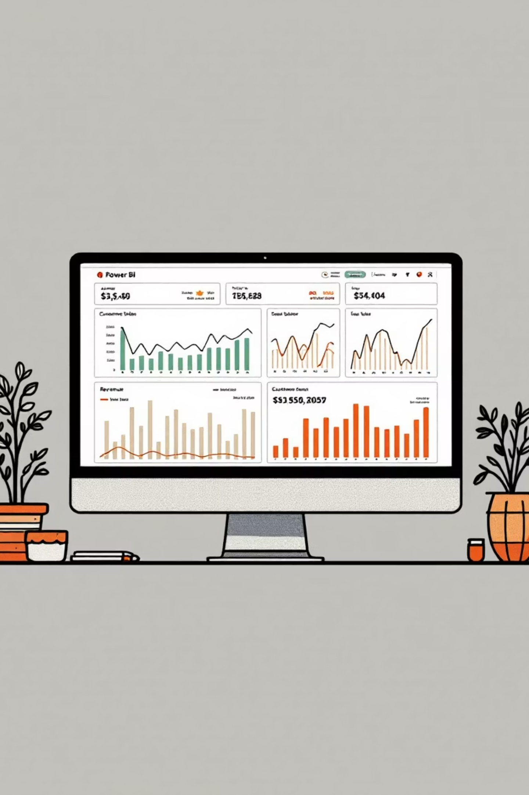
Dashboard Highlights
A centralized hub for real-time performance monitoring and customer segmentation.
KPI Cards
Instant view of revenue, orders, and customer count.
RFM Segment
Visual breakdown of customer value distribution.
Returns Analysis
Tracking return rates by category and geography.
Revenue Trend
Quarterly and annual growth trajectory.

Slide 14



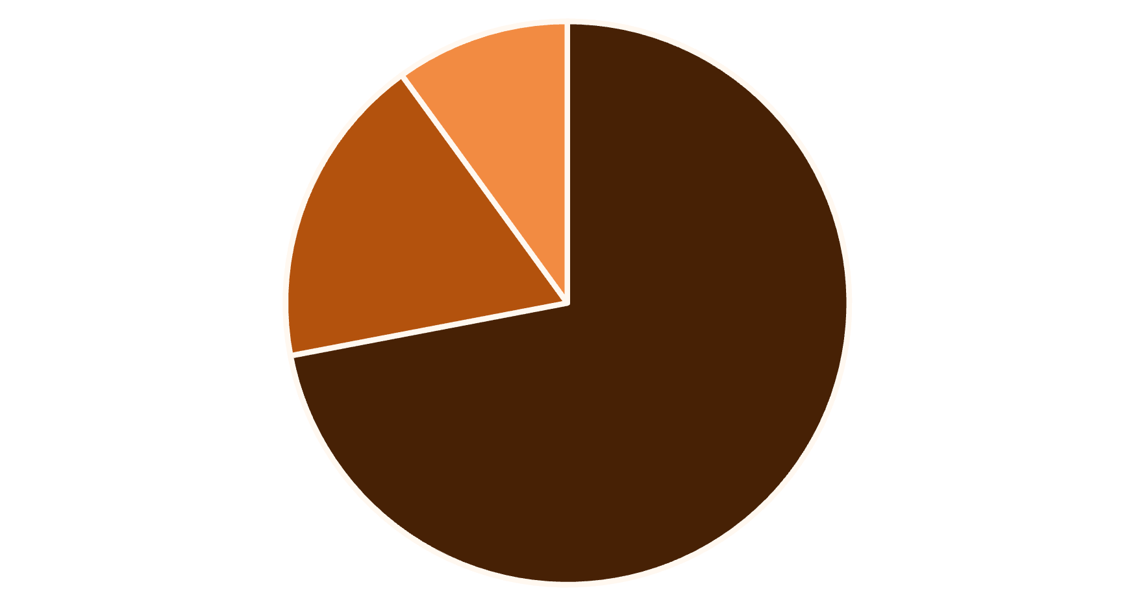
Key Findings: Customer & Revenue Dynamics
Loyal/Potential Loyal
At Risk/Hibernating
New/Other
The RFM analysis confirms a strong foundation of repeat customers, critical for sustained growth.
High Loyalty Base
Core Age Group
72% of customers classified as Loyal or Potential Loyal.
Age range 20–60 drives maximum revenue.
High Return Rate
Approximately 40% of all orders result in a return.

Slide 15

Actionable Business Recommendations
Leveraging insights to drive retention and reduce costs.
RETENTION & RE-ENGAGEMENT
Target "At-Risk" segment with personalized offers.
Implement a tiered loyalty program for "Loyal" customers.
RETURNS REDUCTION
Identify top-returning product categories.
Enhance product descriptions and size guides to minimize fit issues.
MARKETING FOCUS
Focus ad spend on high-conversion age group (20-60).
Develop segmented campaigns based on RFM scores.

Slide 16
Project Conclusion & Impact
Delivering a framework for smarter, data-informed e-commerce operations.
Comprehensive Dashboard
Core Business Insights
Centralized visualization for tracking e-commerce health metrics.
Identified critical 40% return rate and 72% strong loyalty base.
RFM Segmentation Engine
Strategic Decision Support
Foundation for targeted marketing and customer lifecycle management.
Provided clear, actionable steps for growth and efficiency.

Slide 17

THANK YOU

